Slide 1
Anything can be elided if you know how
Till Poppels & Andy Kehler
ECBAE 2020

Slide 2
A brief history of sluicing
Someone solved the problem,
but no one knows who (solved it).
Chung et al. (1995): LF copying => syntactic identity
Merchant (2001): e-GIVENness => semantic identity

Slide 3
A brief history of sluicing
The problem was solved,
but no one knows who #(solved it).
Chung et al. (1995): LF copying => syntactic identity
Merchant (2001): e-GIVENness => semantic identity

Slide 4
A brief history of sluicing: hybrid identity
The problem was solved,
but no one knows who #(solved it).
Chung et al. (1995): LF copying => syntactic identity
Merchant (2001): e-GIVENness => semantic identity
Chung (2006): e-GIVENness + "No New Words" constraint
also adopted by Merchant (2008, 2013) and others
Restricted to "Special Heads" in Chung (2013)
Also derived by Rudin (2019)

Slide 5
A brief history of sluicing: hybrid identity
The problem was solved_{PASSIVE},
but no one knows who #(solved_{ACTIVE} it).
Chung et al. (1995): LF copying => syntactic identity
Merchant (2001): e-GIVENness => semantic identity
Chung (2006): e-GIVENness + "No New Words" constraint
also adopted by Merchant (2008, 2013) and others
Ban constructional mismatches based on lexical mismatches that produce them.
Restricted to "Special Heads" in Chung (2013)
Also derived by Rudin (2019)

Slide 6
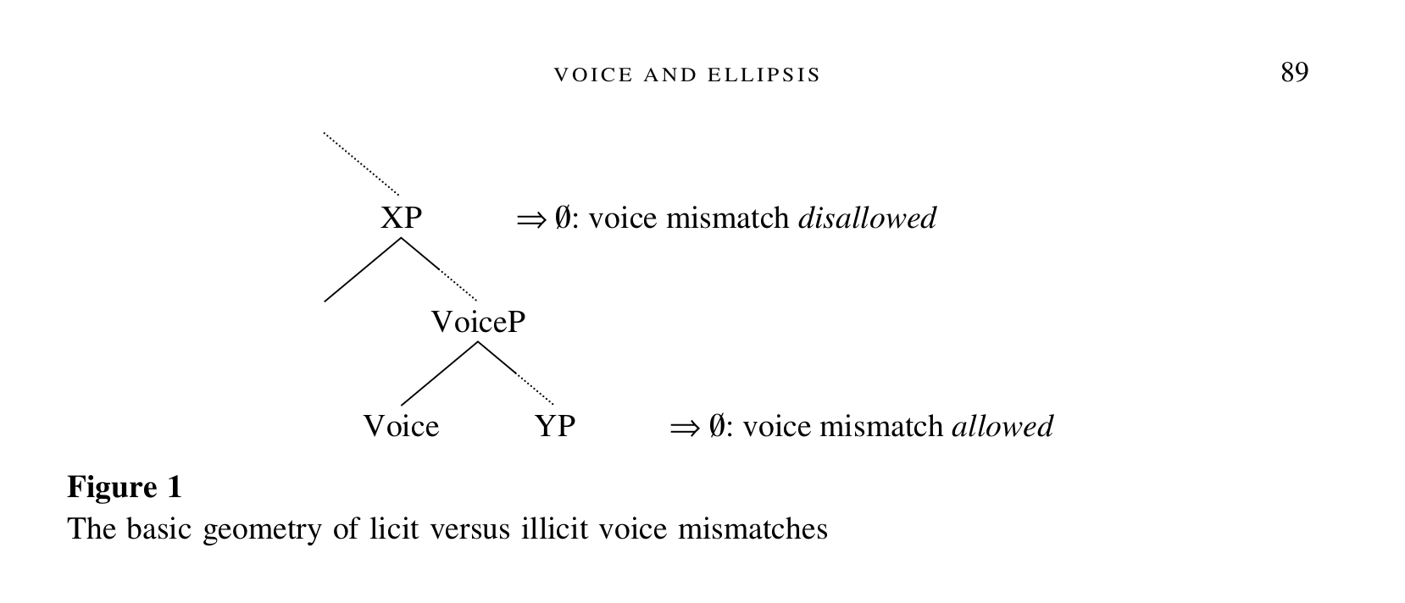
Aside: VP-ellipsis
Voice & VP-ellipsis:
The problem was solved by Bill,
and John did #(solve the problem), too.
The problem was to have been solved,
but obviously nobody did (solve the problem).
(Kehler, 1993)
Tough movement & VP-ellipsis:
It is easy to identify venomous snakes,
and poisonous plants are #(easy to identify), too.
Venemous snakes are easy to identify, and most experienced hikers can (identify them).
(Kertz, 2013)
Merchant (2013)

Slide 7
Research Question
Voice & VP-ellipsis:
The problem was solved by Bill,
and John did #(solve the problem), too.
The problem was to have been solved,
but obviously nobody did (solve the problem).
(Kehler, 1993)
Tough movement & VP-ellipsis:
It is easy to identify venemous snakes,
and poisonous plants are #(easy to identify), too.
Venemous snakes are easy to identify, and most experienced hikers can (identify them).
(Kertz, 2013)
Our Research Question: do all constructional mismatches render sluicing categorically ungrammatical?
Experiment 1: tough movement
Experiment 2: voice mismatches
Merchant (2013)

Slide 8
Experiment 1: tough movement
It's easy to replace brake fluid
if you know how (to replace it).
Brake fluid is easy to replace t
if you know how ?(to replace it).
Brake fluid is easy to replace t
if you know when ?(to replace it).

Slide 9
Experiment 1: tough movement
24 items: (2x2x3 within-item design)
It's easy to replace brake fluid if you know {how|when|where}.
Brake fluid is easy to replace t if you know {how|when|where}.
It's easy to replace brake fluid if you know {how|when|where} to replace it.
Brake fluid is easy to replace t if you know {how|when|where} to replace it.
48 fillers, 41 Mechanical Turk participants

Slide 10
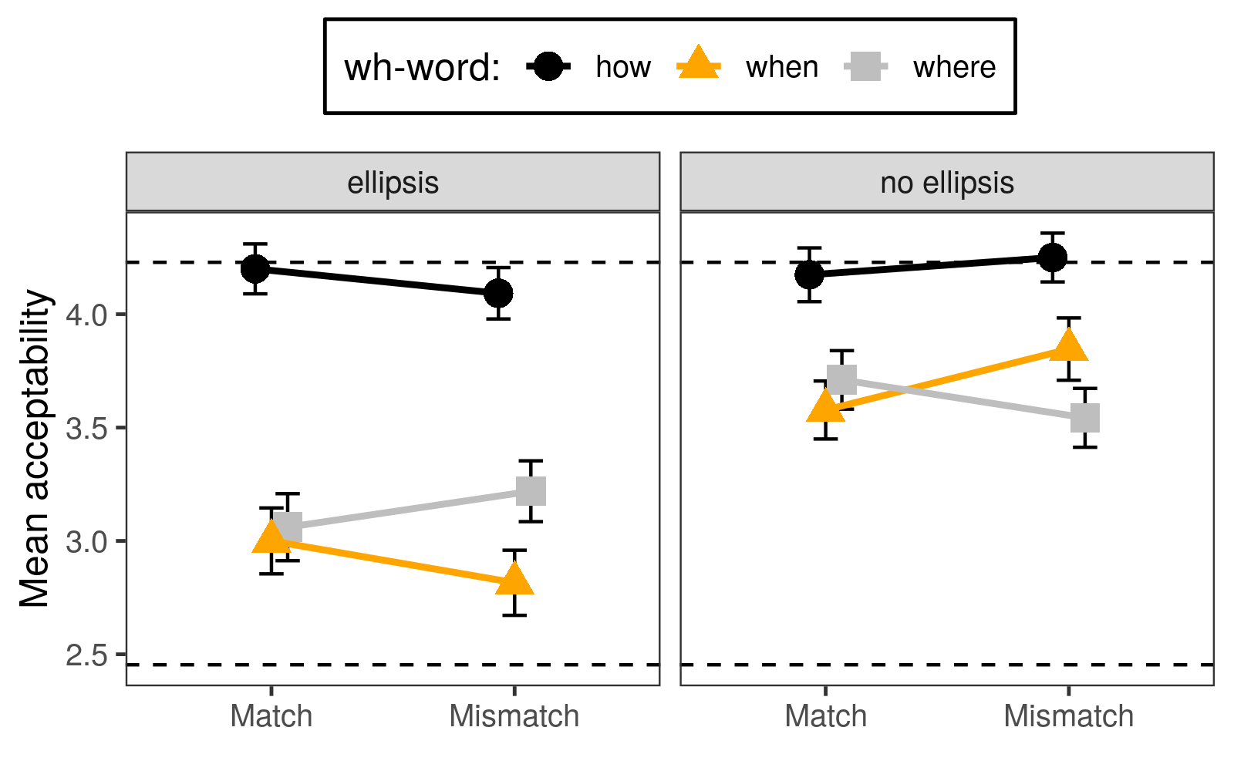
***
***
***
ns
ns

Slide 11
Experiment 1: Discussion
Brake fluid is easy to replace t
if you know how (to replace it).
3 findings | Chung (2006) | Merchant (2013) | Chung (2013) | Rudin (2019)
1. There are fully acceptable sluices under tough movement.
2. No mismatch penalty anywhere.
3. Ellipsis-specific when/where penalties.

Slide 12
Experiment 2: voice mismatches
The problem was solved
but no one knows who #(solved it).
The problem should be solved
but no one knows how ?(to solve it).
?(it should be solved).
The problem hasn't been solved
because no one knows how ?(to solve it).
#(it hasn't been solved).

Slide 13
Experiment 2: voice mismatches
12 items: (2x2x3 design, wh-word varied across items)
Nobody ever solved the problem because no one knows how.
The problem has never been solved t because no one knows how.
Nobody ever solved the problem because no one knows how to solve it.
The problem has never been solved t because no one knows how to solve it.
12 fillers, 47 Mechanical Turk participants
Norming experiment: only 3.2% of sluices received passive-voice paraphrases

Slide 14
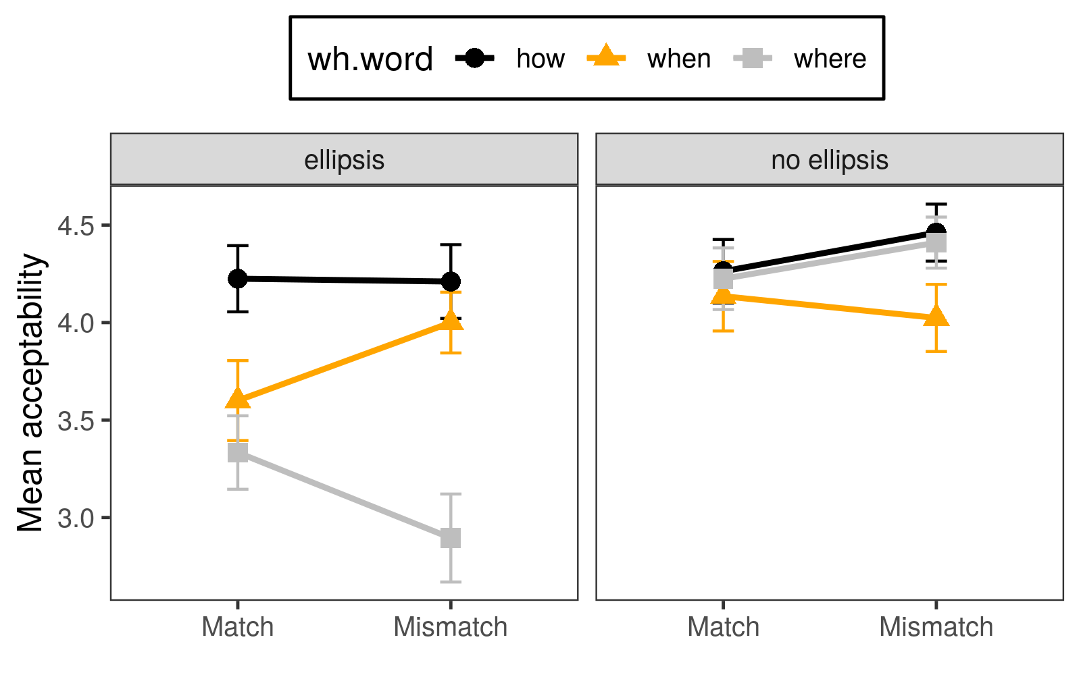
*
***
ns
ns

Slide 15
Experiment 2: Discussion
This problem hasn't been solved
because no one knows how (to solve it).
Chung's (2013) "Special Heads" condition:
"[T]he only predicates in the ellipsis whose argument structures are constrained by syntactic identity are predicates that take the interrogative phrase as their argument."
(Chung, 2013, p. 30)
3 findings | Chung (2006) | Merchant (2013) | Chung (2013) | Rudin (2019)
1. There are fully acceptable sluices under voice mismatch.
2. No mismatch penalty anywhere.
3. Ellipsis-specific when/where penalties.

Slide 16
The when/where penalty (Experiment 1)

Slide 17
The when/where penalty (Experiment 1)
It's easy to replace brake fluid
if you know how (to replace it).
Brake fluid is easy to replace t
if you know how (to replace it).
Brake fluid is easy to replace t
if you know when #(to replace it).

Slide 18
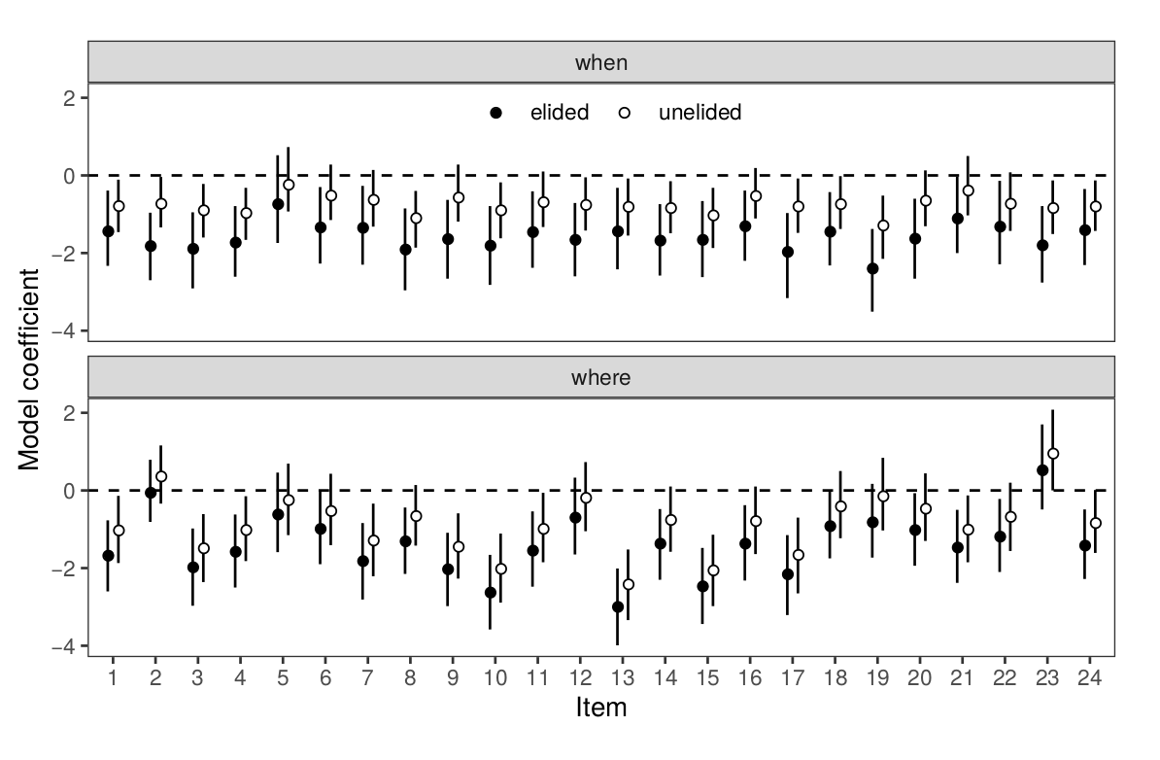

Slide 19
Science can be challenging to explain to children even if you know where.

Slide 20
Large cars are almost impossible to park downtown unless you know where.

Slide 21
Pants that fit perfectly can be impossible to find unless you know where.

Slide 22
Pants that fit perfectly can be impossible to find unless you know when.

Slide 23
Software updates are important to install but it's not always clear when.

Slide 24
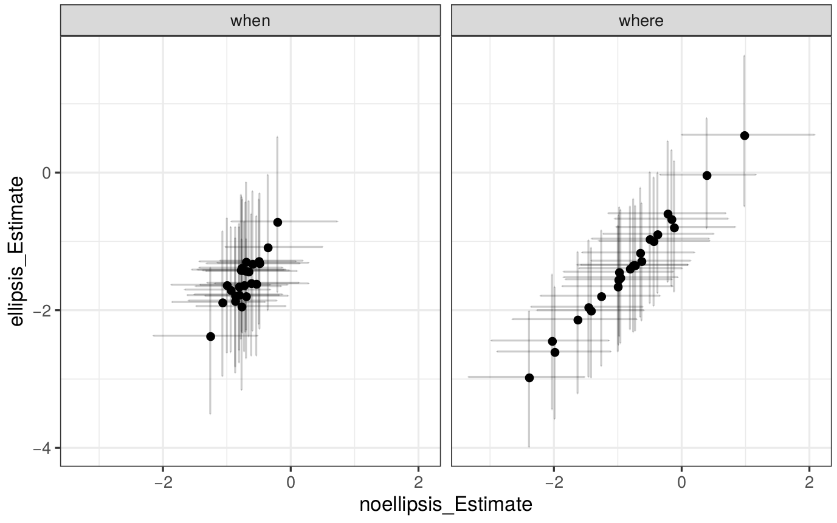
Elided variant
Unelided variant

Slide 25
Elided variant
Unelided variant
Unelided variant

Slide 26
Thank you!

