Slide 1
Long-distance reflexive binding in English Stripping
David Potter & Katy Carlson
Morehead State University
ECBAE 2020 (University of Paris)
July 15th, 2020
davidkpotter@gmail.com

Slide 2
What is the syntax of Ellipsis?
Gapping
Stripping
Sluicing
VPE
Nominal Ellipsis
Fragment Answers
Pseudo-Gapping
LPE

Slide 3
What is the syntax of Ellipsis?
1a. Alex: Jordan called someone.
1b. Parker: Yeah, Jordan called Taylor.
1c. Parker’: Yeah, Taylor.
Stripping
2a. …Jordan called Taylor.
In-situ Ellipsis
(Abe 2015; Ott & Struckmeier 2018)
Remnant doesn’t move
Non-constituent elided
2b. … Taylor_{i} Jordan called __{i}.
Move and Elide
(Merchant 2001, Potter 2017)
Remnant moves
Constituent is elided
Alternative analyses:
2c. … Taylor. Non-structural
2d. …. Taylor_{i} it was __{i}. Non-isomorphic

Slide 4
Reflexives as movement diagnostic under ellipsis
Binding Condition A:
Reflexives must have a c-commanding clausemate binder
3a. The investigators assumed [_{CP} that Taylor had misled herself].
3b. *The investigators assumed [_{CP} that Taylor had misled themselves].
BCA is relaxed in certain long-distance dependencies (Lebaux 1990; Heycock 1995; Fox 2003)
4. It was themselves who the investigators assumed that Taylor had misled _.

Slide 5
Reflexives as movement diagnostic under ellipsis
5a. The investigators assumed that Taylor had misled someone.
5b. Yeah, themselves.
In-situ Ellipsis
6a. …the investigators assumed that Taylor had misled themselves.
6b. *…the investigators assumed that Taylor had misled themselves.
Move and Elide
7a. …themselves the investigators assumed that Taylor had misled _.
7b. …it was themselves who the investigators assumed that Taylor had misled _.

Slide 6
Experiment 1
8a. Alex: The investigators assumed that Taylor had misled someone.
8b. Parker: Yeah, the investigators assumed that Taylor had misled themselves.
Task: Read dialogues and rate the plausibility of the underlined words to referring to the same person (Kazanina et al. 2007; Potter 2017; Yoshida et al. 2018)
Platform: Amazon Mechanical Turk; N=40; 24 items
Design: 2x3
Continuation type: Canonical, It-cleft, Stripping
Pronoun type: Reflexive, Personal pronoun

Slide 7
Experiment 1
Antecedent
9. The investigators assumed that Taylor had misled someone.
Prediction: 10b more plausible than 10a
Canonical
10a. Yeah, the investigators assumed that Taylor had misled themselves.
10b. Yeah, the investigators assumed that Taylor had misled them.
Prediction: 11a more plausible than 11b (Reeve 2013)
It-cleft
11a. Yeah, it was themselves that the investigators assumed that Taylor had misled.
11b. Yeah, it was them that the investigators assumed that Taylor had misled.
Stripping
12a. Yeah, themselves.
12b. Yeah, them.
Predictions:
In-Situ: 12b more plausible than 12a (= 10b v. 10a)
M&E: 12b and 12a equally plausible

Slide 8
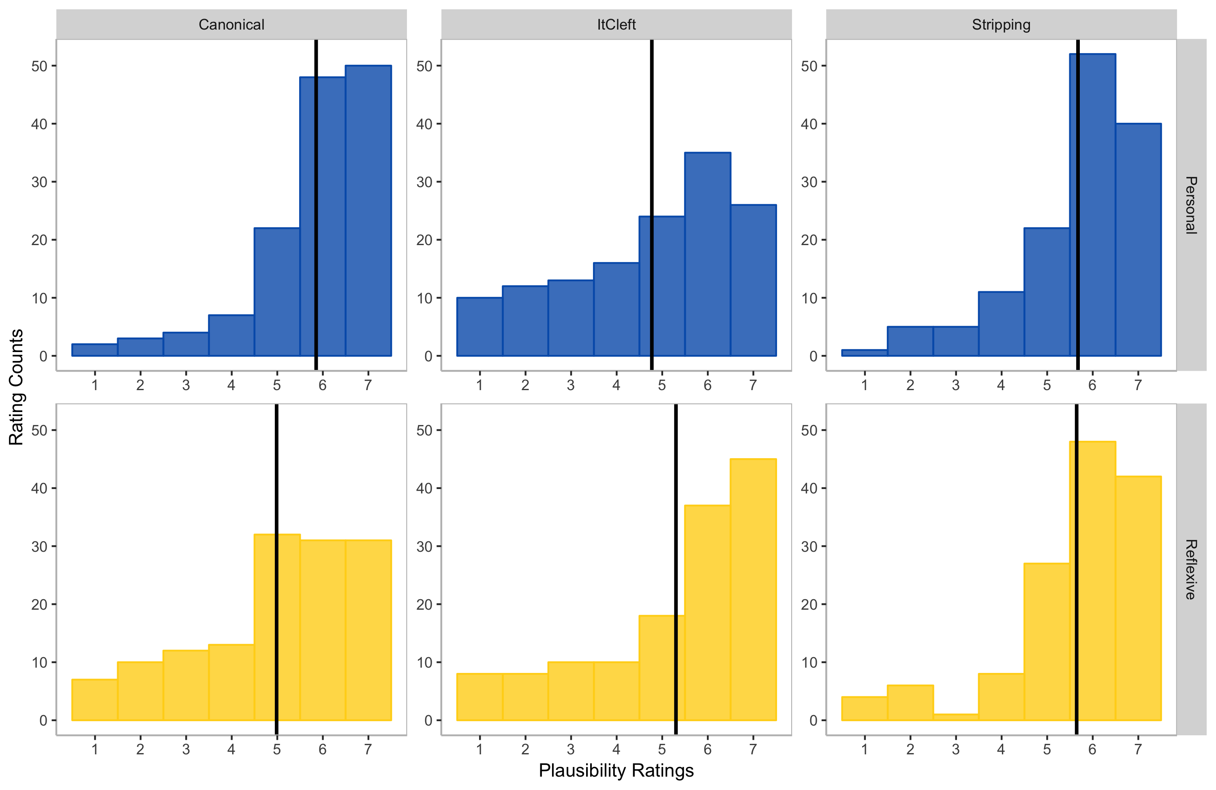
Experiment 1

Slide 9
Experiment 1
Antecedent
9. The investigators assumed that Taylor had misled someone.
Prediction: 10b more plausible than 10a
Canonical
10a. Yeah, the investigators assumed that Taylor had misled themselves.
10b. Yeah, the investigators assumed that Taylor had misled them.
Prediction: 11a more plausible than 11b (Reeve 2013)
It-cleft
11a. Yeah, it was themselves that the investigators assumed that Taylor had misled.
11b. Yeah, it was them that the investigators assumed that Taylor had misled.
Stripping
12a. Yeah, themselves.
12b. Yeah, them.
Predictions:
In-Situ: 12b more plausible than 12a (= 10b v. 10a)
M&E: 12b and 12a equally plausible

Slide 10
Experiment 2
13a. Alex: The investigators assumed that Taylor had misled someone.
13b. Parker: Yeah, the investigators assumed that Taylor had misled themselves.
Task: Acceptability judgments
Platform: Amazon Mechanical Turk; N=44; 24 items
Design: 2x3
Continuation type: Canonical, It-cleft, Stripping
Dependency length: Long, Short

Slide 11
Experiment 2
Antecedent
14. The investigators assumed that Taylor had misled someone.
Prediction: 15b more acceptable than 15a
Canonical
15a. Yeah, the investigators assumed that Taylor had misled themselves.
15b. Yeah, the investigators assumed that Taylor had misled herself.
Prediction: 16a, 16b equally acceptable
It-cleft
16a. Yeah, it was themselves that the investigators assumed that Taylor had misled.
16b. Yeah, it was herself that the investigators assumed that Taylor had misled.
Stripping
17a. Yeah, themselves.
17b. Yeah, herself.
Predictions:
In-Situ: 17b more acceptable than 17a (=15b v. 15a)
M&E: 17a, 17b equally acceptable

Slide 12
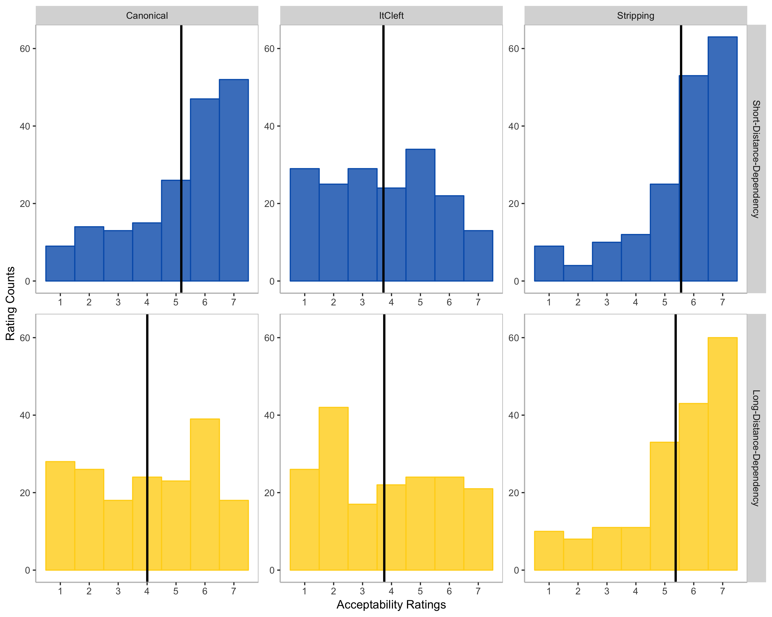
Experiment 2

Slide 13
Experiment 2
Antecedent
14. The investigators assumed that Taylor had misled someone.
Prediction: 15b more acceptable than 15a
Canonical
15a. Yeah, the investigators assumed that Taylor had misled themselves.
15b. Yeah, the investigators assumed that Taylor had misled herself.
Prediction: 16a, 16b equally acceptable
It-cleft
16a. Yeah, it was themselves that the investigators assumed that Taylor had misled.
16b. Yeah, it was herself that the investigators assumed that Taylor had misled.
Stripping
17a. Yeah, themselves.
17b. Yeah, herself.
Predictions:
In-Situ: 17b more acceptable than 17a (=15b v. 15a)
M&E: 17a, 17b equally acceptable

Slide 14
What is the syntax of Ellipsis?
18a. The investigators assumed that Taylor had misled someone.
18b. Yeah, themselves.
In-situ Ellipsis
19a. …the investigators assumed that Taylor had misled themselves.
19b. *…the investigators assumed that Taylor had misled themselves.
Move and Elide
20a. …themselves the investigators assumed that Taylor had misled _.
20b. …it was themselves who the investigators assumed that Taylor had misled _.

Slide 15
Broader implications: Island insensitivity
21a. Taylor met [_{Relative Clause} the student who had misled someone].
21b. Yeah, Jordan. (Potter 2017)
21c. *Who did Taylor meet [_{Relative Clause} the student who had misled]?
In-situ Ellipsis
22a. …Taylor met [_{Relative Clause} the student who had misled Jordan].
22b. …Taylor met [_{Relative Clause} the student who had misled Jordan].
Move and Elide
23a. … Jordan Taylor met [_{Relative Clause} the student who had misled _].
23b. *…it was Jordan who Taylor met the student who had misled _.

Slide 16
Thank you!
Research Support: NICHD R15HD072713, NIH 5P20GM103436-13
Thanks to Masaya Yoshida, Mike Frazier, & Kyle Johnson for helpful discussions.
Thanks to K. Griffitts, V. Nash, T. Vetter, & C. Gibson for experimental assistance.
My deepest gratitude to the McNair Scholars Program
https://mcnairscholars.com

Slide 17
Experiment 1
Small effects overall (relative to intuitive judgments for e.g. BCA)
In the absence of an explicit theory linking absolute ratings and grammaticality, this shouldn’t concern us
We are concerned with contrasts: All else equal, does manipulation X lead to a contrast in acceptability?
Confirmed judgments reported in Reeve (2013)
Yeah, it was themselves/*them that the investigators assumed that Steven had misled.
BCA must be satisfied at some level of representation (Belletti and Rizzi, 1988; Fox 2003)
BCC must be satisfied at every level of representation
Experimental evidence for Vehicle Change effects:
No BCC effect in the Stripping conditions:
Yeah, themselves/them the investigators assumed that Steven had misled _.
Yeah, them they assumed that Steven had misled _.

Slide 18
Experiment 2
Small effects overall (relative to intuitive judgments for e.g. BCA)
It-clefts less acceptable than Stripping & Canonical conditions
Likely effect of length &/or repetition
Short dependencies more acceptable than long
Driven by effect in Canonical conditions;
No effect of length in both Stripping and It-cleft conditions

Slide 19
Alternative analyses
24a. The investigators assumed that Taylor had misled someone.
24b. Yeah, themselves.
Non-structural: How is BCA satisfied in the absence of a local binder?
25. …themselves.
Non-isomorphic: Behaviour of reduced clefts? (What is their analysis? Ellipsis?)
26a. …themselves it was_.
26b. …it was themselves.

Slide 20
Ellipsis remnant reflexives & it-cleft pivots are not exempt anaphors
Büring (2005): “1st and 2nd person exempt anaphors don’t need linguistic antecedents at all”; (27, 30)
But reflexives in cleft pivot and ellipsis remnant positions require antecedents (exp. evidence needed!):
1st person reflexive pronouns:
27. There were five tourists in the room apart from myself.
28a. ??It was myself that Taylor embarrassed.
28b. It was myself that I embarrassed.
29a. Taylor embarrassed someone.
29b. ??Yeah, myself.
2nd person reflexive pronouns:
30. Physicists like yourself are a godsend.
31a. *It was yourself that Taylor embarrassed.
31b. It was yourself that you embarrassed.
32a. Taylor embarrassed someone.
32b. *Yeah, yourself.
Reinhart & Reuland (1993): focused anaphors are exempt (33)
But in these experiments, the anaphors across all conditions were focused (34)
If R&R were correct, the contrast seen between continuation types remains unexplained
33. This letter was addressed only to myself_i.
34a. Yeah, the investigators assumed that Taylor had misled themselves.
34b. Yeah, themselves.

